Slide 1
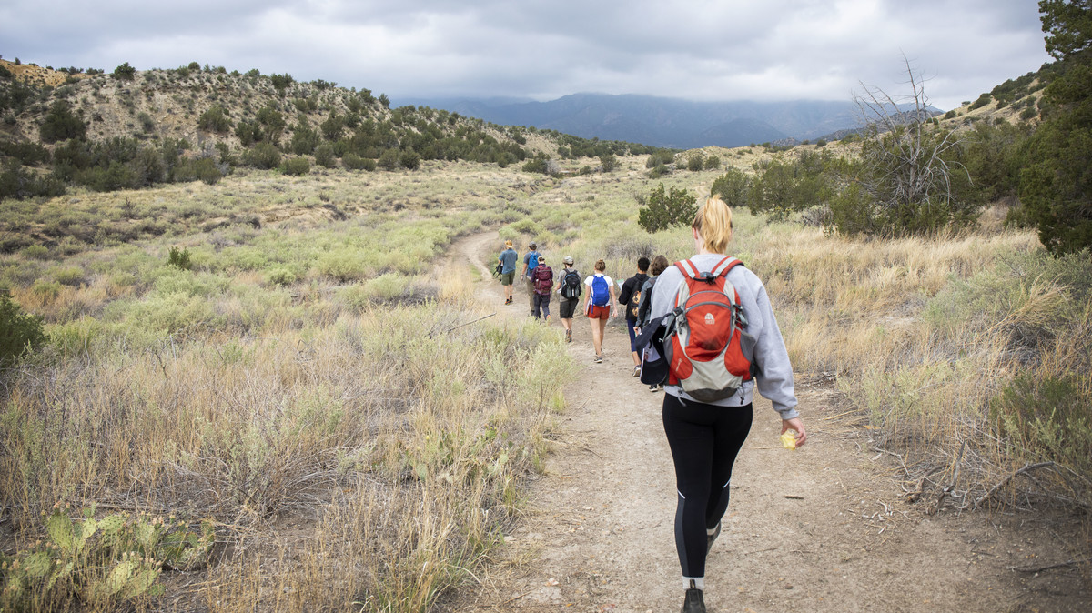
Colorado College summer session
SUMMER SESSION 2018 REVIEW
BY JIM BURKE, DIRECTOR OF SUMMER SESSION

Slide 2
SUMMER 2018
ENROLLMENT BREAKDOWN: AGGREGATE DATA

Slide 3
SUMMER 2018
COURSES LISTED vs COURSES TAUGHT
Number undergraduate courses offered (and taught) on campus
 | 2014 |  | 2015 |  | 2016 |  | 2017 |  | 2018
 | Listed | Cancelled | Listed | Cancelled | Listed | Cancelled | Listed | Cancelled | Listed | Cancelled
Block A | 23 | 2 | 15 | 3 | 12 | 7 | 12 | 7 | 19 | 4
Block B | 20 | 4 | 18 | 1 | 14 | 1 | 14 | 1 | 12 | 1
Extended Session Block AB, Half Unit | 1 | 0 | 1 | 0 | 7 | 3 | 5 | 3 | 2 | 2
Total | 44 | 6 | 34 | 4 | 33 | 11 | 31 | 11 | 33 | 7
Off-campus courses offered/listed:
Ten courses approved; one canceled (Israel due to security issues), nine taught
Eight of nine were international (all but Chicago)
Professors | Course Department & Course Number | Course Title | Course Country | Units | Final Enrollment
Gould, John & Gould, Simona | PS203 | Central Europe's Great Post-Communist Journey, 1989 to the Present | Slovakia, Czech Republic, Poland, Hungary | 1 | 15
Hayward, Steven & Carlstrom, Katherine | EN 225/EN 401 | Introduction to Shakespeare: Shakespeare & London | England | 1 | 8
Lewis, Heidi & Asbury, Dana | FG214 | Hidden Spaces, Hidden Narratives: Intersectionality Studies in Berlin | Germany | 1 | 12
Sarchett, Barry & Hughes, Lisa | CO220/CL222/HY200 | The World of Odysseus: History & Myth | Greece | 1 | 16
Macy, Elizabeth & Lasmawan, I. | MU222/AN222 | The Arts & Culture of Bali | Indonesia | 1 | 12
Thakur, Sanjaya & Buxton, Richard | CL322/AH200/CO220/HY200 | Rome, Naples, Sicily: Crossroads of the Ancient Mediterranean | Italy | 1.5 | 16
Coburn, Broughton & Kummel, Miroslav | EV120 | Himalayan Odyssey: Environment, Culture, & Change in Nepal | Nepal | 1 | 15
Ruiz, Carrie & Ciam, Ciam | SP111, SP211, SP305, SP306 | Elementary/ Intermediate/Advanced | Spain | 2 | 34
Riker, John & Dobson, Marcia | PH263/CO200 | Contemporary Psychoanalysis: Theory and Practice | USA: Chicago | 1 | 15
 |  |  |  |  | 143

Slide 4
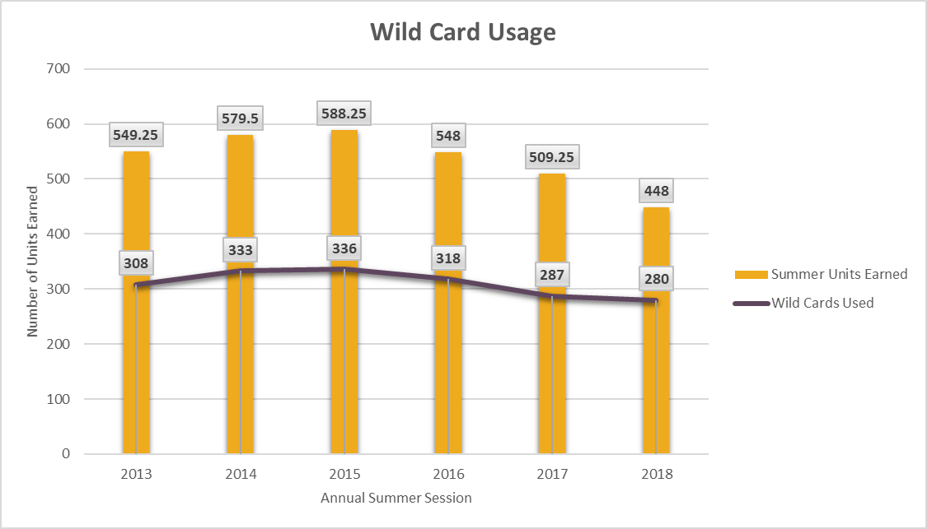
SUMMER 2018
WILD CARD USAGE
POINTS OF CONSIDERATION
3% decrease in Wild Card usage
Consistent with 2017, 36% of graduating seniors did not use their Wild Card

Slide 5
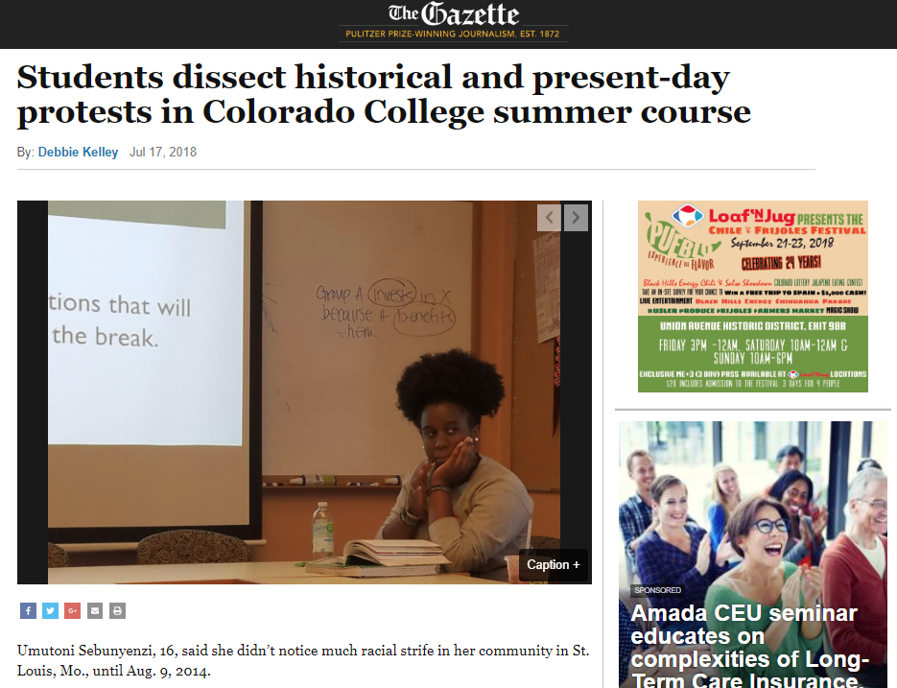
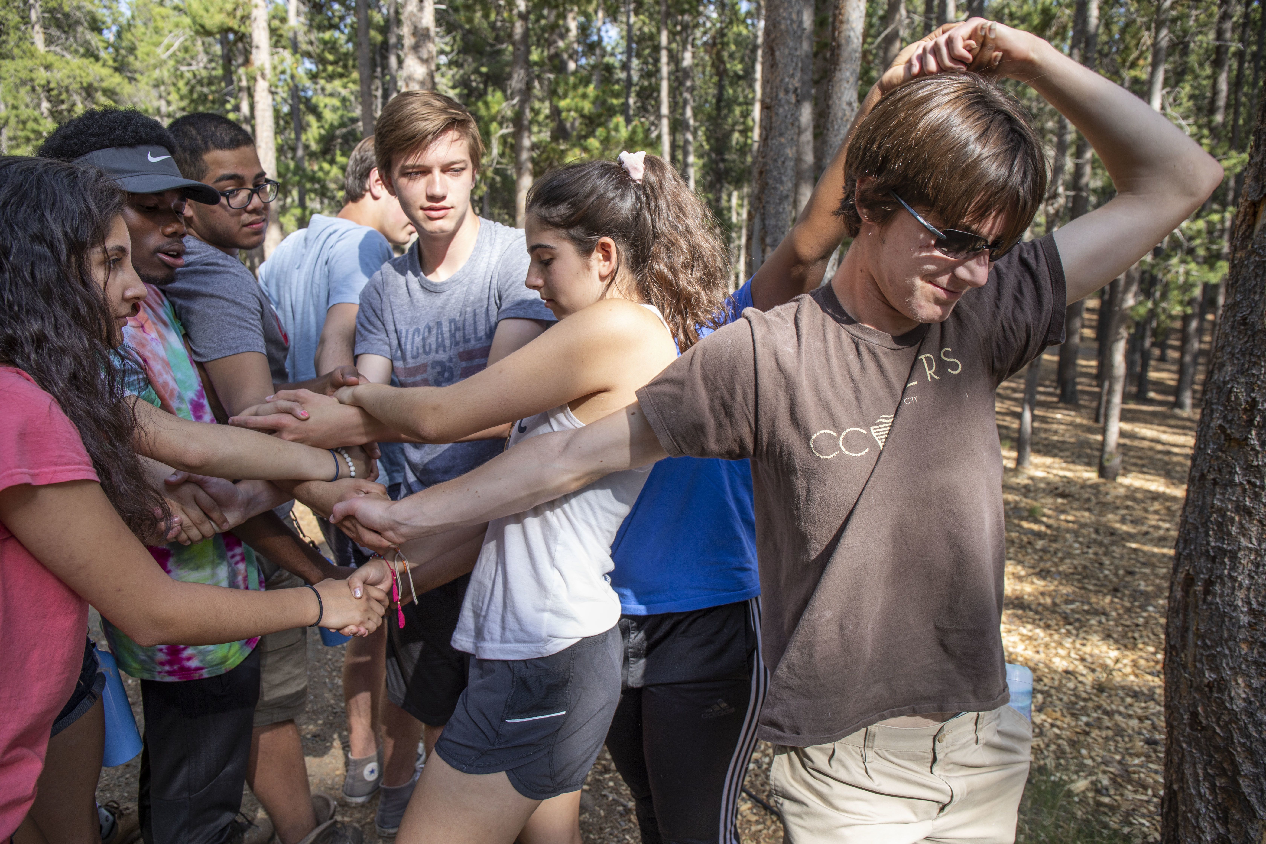
SUMMER 2017
PRE-COLLEGE ENROLLMENT
Highlights
48 Students Enrolled in Pre-College 2018
14 States
3 Countries
Top Enrolled States
17 CO
6 IL
3 CA/CT/MA/NY
15 Need-Based Scholarships Awarded
6 Awarded to Colorado Students
2019 application will move to Slate, as we continue to work closely with the Admissions Office on recruitment and communications
Course offerings
2018 Pre-College Block Course Offerings
Environmental Science From Grassland to Glacier - Mike Taber
English Cross Genre Writing Workshop - Steven Hayward
Political Science Freedom and Empire: The Drama of Ancient Politics – John Grace
Political Science Global Health and International Development – Andrew Price Smith
Feminist and Gender Studies
Do #AllLivesMatter?: Historical and Contemporary Protest in the US – Heidi R. Lewis
2019 Pre-College Block Expected Course Additions
Biophysics
Art

Slide 6
SUMMER 2018
BUILDING CONNECTIONS ACROSS CAMPUS
SUMMER WORKSHOPS
Non-credit collaborations with departments
Art as Literacy Workshop
Participants shadowed 1 week of ED510: Art as Literacy
The goal was to continue to engage the local community of teachers and feature a unique collaboration with FAC & CC’s Education Dept
2 participants enrolled, $400 fee was assessed for each participant
Bluegrass Workshop
9 participants
Participant ages ranged from 16-60
Participants came from CO, NY, TN, UT
4 day workshop on improving musicians’ skills in instrumental techniques, singing, songwriting, and ensemble performance
Program was self-supporting and cost $1,000/participant
The program supported the Music Department’s continued efforts to establish Colorado College as the cultural hub of Colorado Springs and in the Rocky Mountain West region. It also contributed to Summer Session’s ongoing goal of “build a nationally recognized summer program.”
CROSS-CAMPUS COMMITTEE ON SUMMER PROGRAMMING (CCSP)
Created to refresh and operationalize plans for a nationally recognized summer program, as well as, inform the CC Community of strategic plan successes advanced in the summer.
Current recommendations from the committee include,
Utilize summer blocks to intentionally address bottleneck courses and provide extended formats allowing for STEM and language course mastery.
Expand Half Block offerings (credit and non-credit) to the summer months.
Develop a culture of research across disciplines through enhanced Summer Collaborative Research (SCoRe) and external research experiences for undergraduates
Summer 2018 CCSP Progress
Offered two .5 unit in-demand Half Block courses
EV127 Intro to GIS and HK120 Physiology of Muscular Adaptation
EV127 was cancelled, HK120 ran
Mixed success, don’t see this being repeated – demand was limited and issues exist with applying Wild Card
https://www.coloradocollege.edu/other/ccsp/

Slide 7
SUMMER 2018
QUESTIONS?
Questions?

